Slide 1
Chapter 13
Graphics classes
Bjarne Stroustrup
www.stroustrup.com/Programming

Slide 2
Abstract
Chapter 12 demonstrated how to create simple windows and display basic shapes: rectangle, circle, triangle, and ellipse. It showed how to manipulate such shapes: change colors and line style, add text, etc.
Chapter 13 shows how these shapes and operations are implemented, and shows a few more examples. In Chapter 12, we were basically tool users; here we become tool builders.
Stroustrup/Programming

Slide 3
Overview
Graphing
  Model
  Code organization
Interface classes
  Point
  Line
  Lines
  Grid
  Open Polylines
  Closed Polylines
  Color
  Text
  Unnamed objects
Stroustrup/Programming

Slide 4
Display model
Open_polyline
draw()
Display
Engine
attach()
draw()
“window”
attach()
Rectangle
draw()
Objects (such as graphs) are “attached to” (“placed in”) a window.
The “display engine” invokes display commands (such as “draw line from x to y”) for the objects in a window
Objects such as Rectangle add vectors of lines to the window to draw
Stroustrup/Programming

Slide 5
Code organization
FLTK headers
Point.h:
struct Point { … };
FLTK code
Graph.h:
Window.h:
GUI.h:
// Graphing interface:
struct Shape { … };
…
// window interface:
class Window {…};
…
// GUI interface:
struct In_box { … };
…
Graph.cpp:
Window.cpp:
Graph code
Window code
chapter12.cpp:
#include "Graph.h"
#include "Window.h"
int main() { … }
GUI.cpp:
GUI code
Stroustrup/Programming

Slide 6
Source files
Header
  File that contains interface information (declarations)
  #include in user and implementer
.cpp (“code file” / “implementation file”)
  File that contains code implementing interfaces defined in headers and/or uses such interfaces
  #includes headers
Read the Graph.h header
  And later the Graph.cpp implementation file
Don’t read the Window.h header or the Window.cpp implementation file
  Naturally, some of you will take a peek
  Beware: heavy use of yet unexplained C++ features
Stroustrup/Programming

Slide 7
Design note
The ideal of program design is to represent concepts directly in code
  We take this ideal very seriously
For example:
  Window – a window as we see it on the screen
    Will look different on different operating systems (not our business)
  Line – a line as you see it in a window on the screen
  Point – a coordinate point
  Shape – what’s common to shapes
    (imperfectly explained for now; all details in Chapter 14)
  Color – as you see it on the screen
Stroustrup/Programming

Slide 8
Point
namespace Graph_lib // our graphics interface is in Graph_lib
{
struct Point // a Point is simply a pair of ints (the coordinates)
{
int x, y;
Point(int xx, int yy) : x(xx), y(yy) { }
}; // Note the ';'
}
Stroustrup/Programming

Slide 9
Line
struct Shape {
// hold lines represented as pairs of points
// knows how to display lines
};
struct Line : Shape // a Line is a Shape defined by just two Points
{
Line(Point p1, Point p2);
};
Line::Line(Point p1, Point p2) // construct a line from p1 to p2
{
add(p1); // add p1 to this shape (add() is provided by Shape)
add(p2); // add p2 to this shape
}
Stroustrup/Programming

Slide 10
Line example
// draw two lines:
using namespace Graph_lib;
Simple_window win(Point(100,100),600,400,"Canvas"); // make a window
Line horizontal(Point(100,100),Point(200,100)); // make a horizontal line
Line vertical(Point(150,50),Point(150,150)); // make a vertical line
win.attach(horizontal); // attach the lines to the window
win.attach(vertical);
win.wait_for_button(); // Display!
Stroustrup/Programming

Slide 11
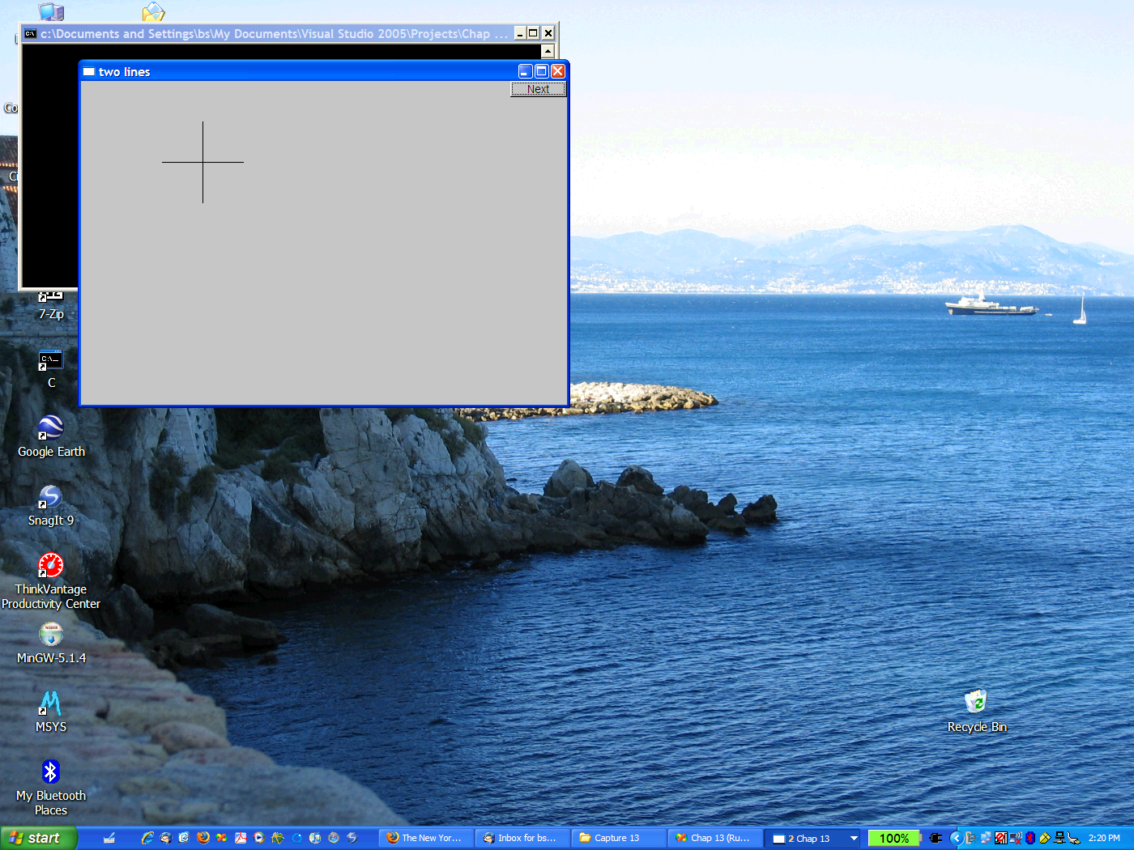
Line example
Stroustrup/Programming

Slide 12
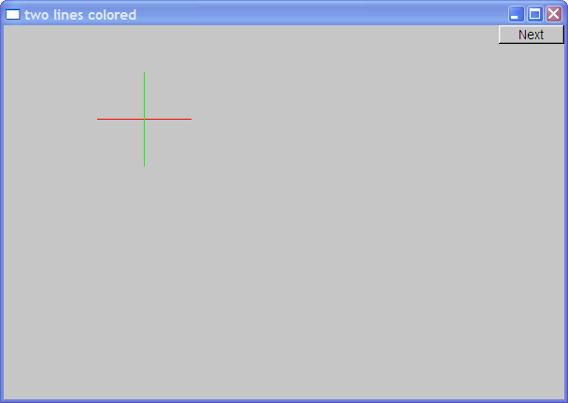
Line example
Individual lines are independent
horizontal.set_color(Color::red);
vertical.set_color(Color::green);
Stroustrup/Programming

Slide 13
Lines
struct Lines : Shape { // a Lines object is a set of lines
// We use Lines when we want to manipulate
// all the lines as one shape, e.g. move them all
// together with one move statement
void add(Point p1, Point p2); // add line from p1 to p2
void draw_lines() const; // to be called by Window to draw Lines
};
Terminology:
  Lines “is derived from” Shape
  Lines “inherits from” Shape
  Lines “is a kind of” Shape
  Shape “is the base” of Lines
This is the key to what is called “object-oriented programming”
  We’ll get back to this in Chapter 14
Stroustrup/Programming

Slide 14
Lines Example
Lines x;
x.add(Point(100,100), Point(200,100)); // horizontal line
x.add(Point(150,50), Point(150,150)); // vertical line
win.attach(x); // attach Lines object x to Window win
win.wait_for_button(); // Draw!
Stroustrup/Programming

Slide 15
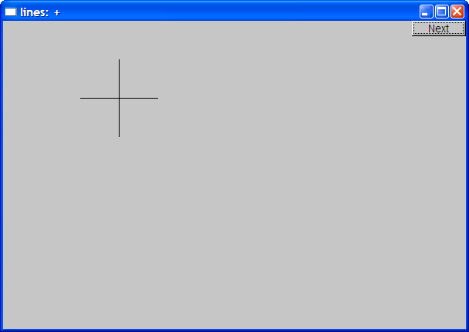
Lines example
Looks exactly like the two Lines example
Stroustrup/Programming

Slide 16
Implementation: Lines
void Lines::add(Point p1, Point p2) // use Shape’s add()
{
Shape::add(p1);
Shape::add(p2);
}
void Lines::draw_lines() const // to somehow be called from Shape
{
for (int i=1; i<number_of_points(); i+=2)
fl_line(point(i-1).x, point(i-1).y, point(i).x, point(i).y);
}
Note
  fl_line is a basic line drawing function from FLTK
  FLTK is used in the implementation, not in the interface to our classes
  We could replace FLTK with another graphics library
Stroustrup/Programming

Slide 17
Draw Grid
(Why bother with Lines when we have Line?)
// A Lines object may hold many related lines
// Here we construct a grid:
int x_size = win.x_max();
int y_size = win.y_max();
int x_grid = 80; // make cells 80 pixels wide
int y_grid = 40; // make cells 40 pixels high
Lines grid;
for (int x=x_grid; x<x_size; x+=x_grid) // veritcal lines
grid.add(Point(x,0),Point(x,y_size));
for (int y = y_grid; y<y_size; y+=y_grid) // horizontal lines
grid.add(Point(0,y),Point(x_size,y));
win.attach(grid); // attach our grid to our window (note grid is one object)
Stroustrup/Programming

Slide 18
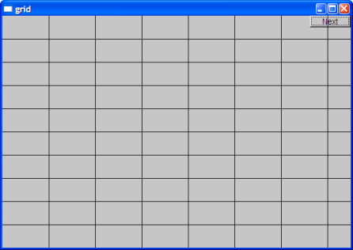
Grid
Oops! Last column is narrow, there's a grid line on top of the Next button, etc.—tweaking required (as usual)
Stroustrup/Programming

Slide 19
Color
struct Color { // Map FLTK colors and scope them;
// deal with visibility/transparency
enum Color_type { red=FL_RED, blue=FL_BLUE, /* … */ };
enum Transparency { invisible=0, visible=255 }; // also called Alpha
Color(Color_type cc) :c(Fl_Color(cc)), v(visible) { }
Color(int cc) :c(Fl_Color(cc)), v(visible) { }
Color(Color_type cc, Transparency t) :c(Fl_Color(cc)), v(t) { }
int as_int() const { return c; }
Transparency visibility() { return v; }
void set_visibility(Transparency t) { v = t; }
private:
Fl_Color c;
char v;
};
Stroustrup/Programming

Slide 20
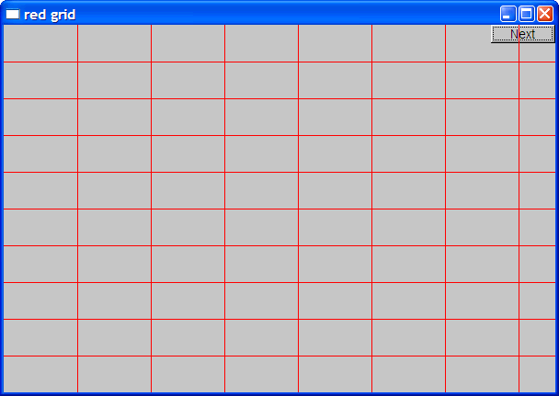
Draw red grid
grid.set_color(Color::red);
Stroustrup/Programming

Slide 21
Line_style
struct Line_style {
enum Line_style_type {
solid=FL_SOLID, // -------
dash=FL_DASH, // - - - -
dot=FL_DOT, // .......
dashdot=FL_DASHDOT, // - . - .
dashdotdot=FL_DASHDOTDOT, // -..-..
};
Line_style(Line_style_type ss) :s(ss), w(0) { }
Line_style(Line_style_type lst, int ww) :s(lst), w(ww) { }
Line_style(int ss) :s(ss), w(0) { }
int width() const { return w; }
int style() const { return s; }
private:
int s;
int w;
};
Stroustrup/Programming

Slide 22
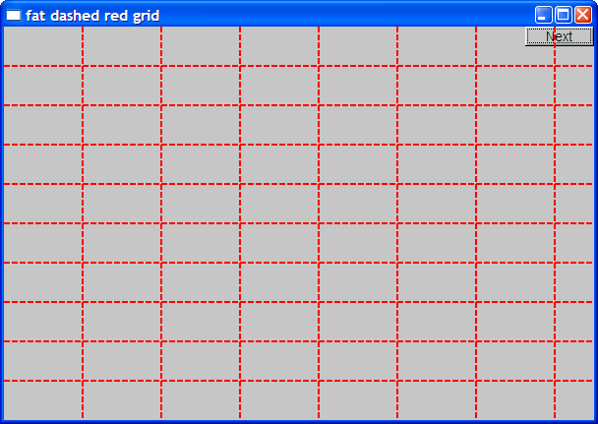
Example: colored fat dash grid
grid.set_style(Line_style(Line_style::dash,2));
Stroustrup/Programming

Slide 23
Polylines
struct Open_polyline : Shape { // open sequence of lines
void add(Point p) { Shape::add(p); }
};
struct Closed_polyline : Open_polyline { // closed sequence of lines
void draw_lines() const
{
Open_polyline::draw_lines(); // draw lines (except the closing one)
// draw the closing line:
fl_line( point(number_of_points()-1).x,
point(number_of_points()-1).y,
point(0).x,
point(0).y
);
}
void add(Point p) { Shape::add(p); } // not needed (why?)
};
Stroustrup/Programming

Slide 24
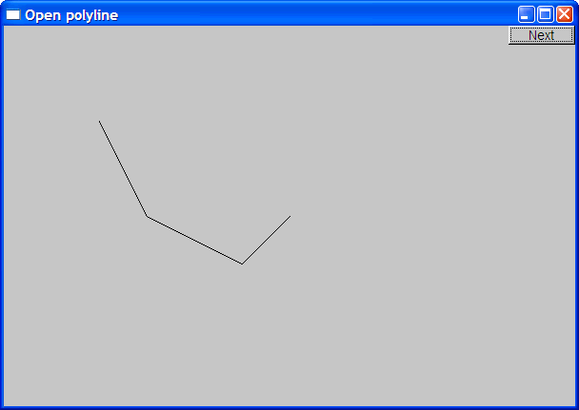
Open_polyline
Open_polyline opl;
opl.add(Point(100,100));
opl.add(Point(150,200));
opl.add(Point(250,250));
opl.add(Point(300,200));
Stroustrup/Programming

Slide 25

Closed_polyline
Closed_polyline cpl;
cpl.add(Point(100,100));
cpl.add(Point(150,200));
cpl.add(Point(250,250));
cpl.add(Point(300,200));
Stroustrup/Programming

Slide 26
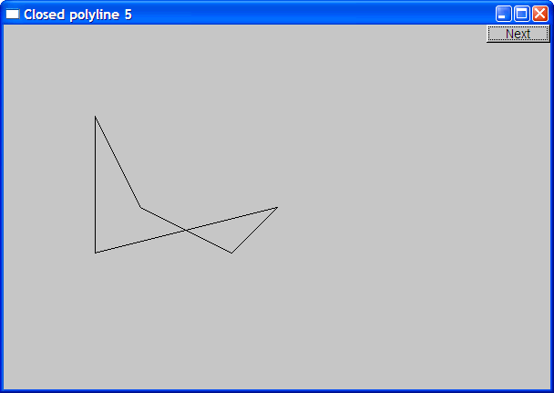
Closed_polyline
cpl.add(Point(100,250));
A Closed_polyline is not a polygon
  some closed_polylines look like polygons
  A Polygon is a Closed_polyline where no lines cross
    A Polygon has a stronger invariant than a Closed_polyline
Stroustrup/Programming

Slide 27
Text
struct Text : Shape {
Text(Point x, const string& s) // x is the bottom left of the first letter
: lab(s),
fnt(fl_font()), // default character font
fnt_sz(fl_size()) // default character size
{ add(x); } // store x in the Shape part of the Text object
void draw_lines() const;
// … the usual “getter and setter” member functions …
private:
string lab; // label
Font fnt; // character font of label
int fnt_sz; // size of characters in pixels
};
Stroustrup/Programming

Slide 28
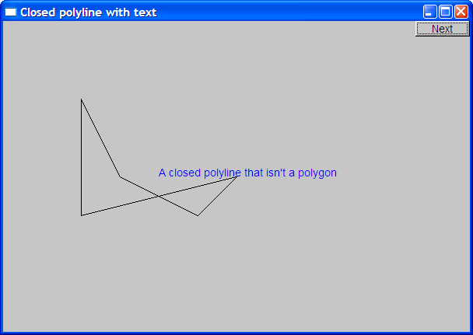
Add text
Text t(Point(200,200), "A closed polyline that isn’t a polygon");
t.set_color(Color::blue);
Stroustrup/Programming

Slide 29
Implementation: Text
void Text::draw_lines() const
{
fl_draw(lab.c_str(), point(0).x, point(0).y);
}
// fl_draw() is a basic text drawing function from FLTK
Stroustrup/Programming

Slide 30
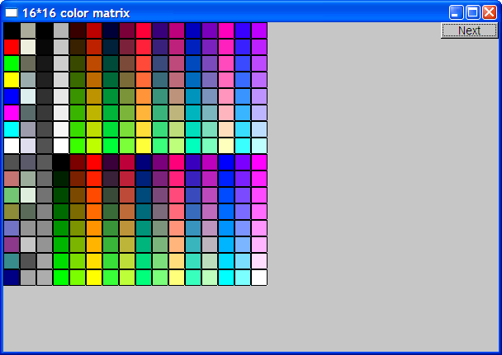
Color matrix
Let’s draw a color matrix
  To see some of the colors we have to work with
  To see how messy two-dimensional addressing can be
    See Chapter 24 for real matrices
  To see how to avoid inventing names for hundreds of objects
Stroustrup/Programming

Slide 31
Color Matrix (16*16)
Simple_window win20(pt,600,400,"16*16 color matrix");
Vector_ref<Rectangle> vr; // use like vector
// but imagine that it holds references to objects
for (int i = 0; i<16; ++i) { // i is the horizontal coordinate
for (int j = 0; j<16; ++j) { // j is the vertical coordinate
vr.push_back(new Rectangle(Point(i*20,j*20),20,20));
vr[vr.size()-1].set_fill_color(i*16+j);
win20.attach(vr[vr.size()-1]);
}
// new makes an object that you can give to a Vector_ref to hold
// Vector_ref is built using std::vector, but is not in the standard library
Stroustrup/Programming

Slide 32
Color matrix (16*16)
More examples and graphics classes in the book (chapter 13)
Stroustrup/Programming

Slide 33
Next lecture
What is class Shape?
Introduction to object-oriented programming
Stroustrup/Programming

